Slide 1
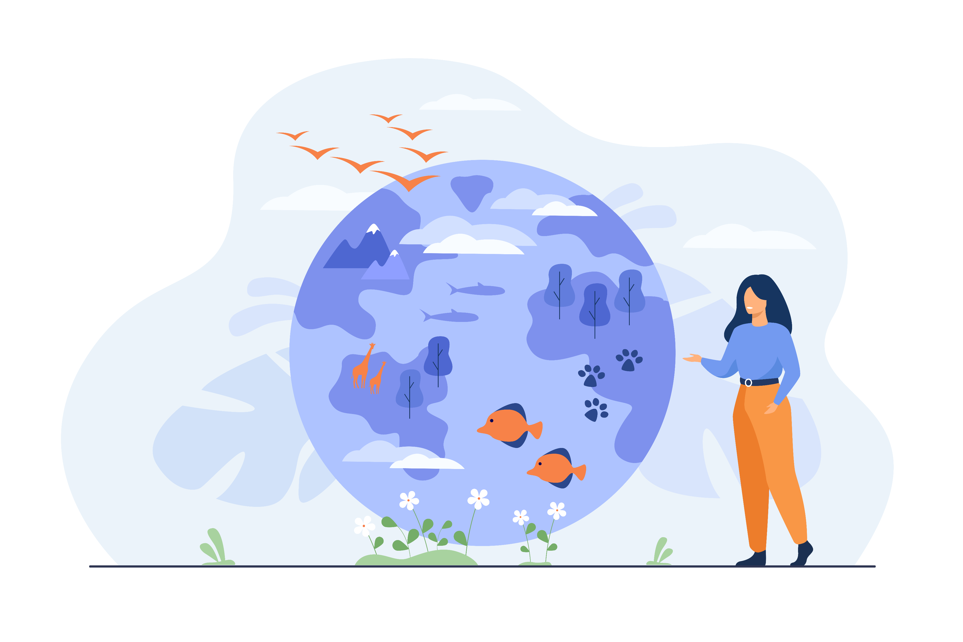

Unit-2
Ecology and Ecosystem
Environmental Studies (ES)
CO2 - interpret concept of ecology and ecosystem.
Prof. Arjun C. Chavada
Civil Engineering Department,
arjun.chavada@darshan.ac.in
8200802523

Slide 2

Looping
Topics
  Introduction to ecology & ecosystem
  Objective of ecology
  Classification of ecology
  Structure of ecosystem
  Food chain & food web
  Ecological pyramid
  Energy flow
  Biogeochemical cycle

Slide 3
Introduction to Ecology & Ecosystem

Slide 4
Introduction
The word Ecology is derived from two Greek words “oikos” meaning house, habitation, or place of living, and “logas”, meaning study.
“A system in which both living and nonliving beings interact with each other as a unit is called an ecosystem.”
Ecology is the study of interrelationship between living organisms and, their physical and biological environment.
Ecology helps in understanding problems relating to certain ecosystems.
It is of great importance in the field of agriculture, forestry, public health, etc.

Slide 5
Objective of ecology

Slide 6
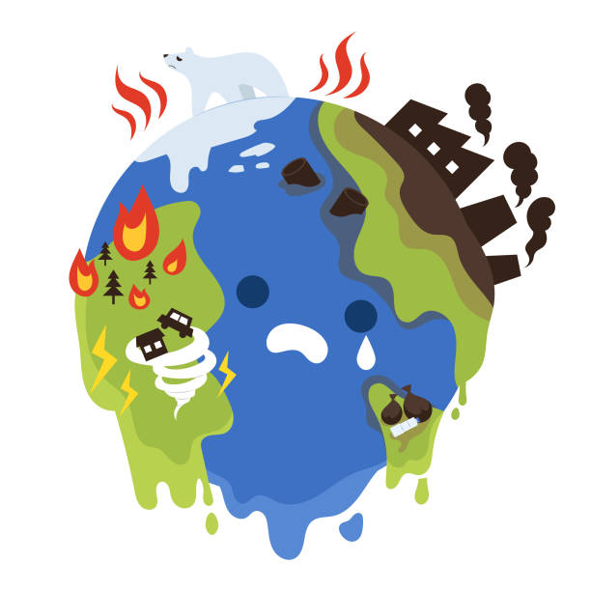
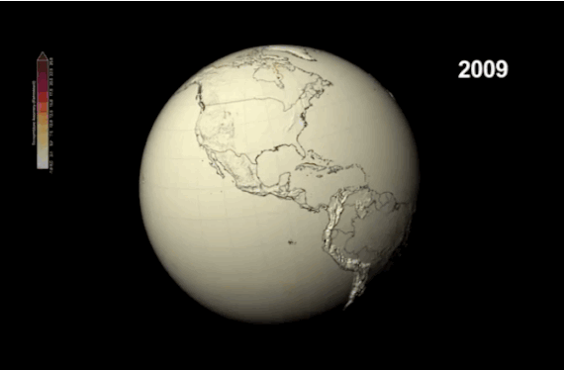
Objectives of Ecology
To describe the flow of energy.
To study temporal changes in the environment.
To study the ecological levels of the ecosystem
To understand the effects of destruction of habitat, pollution, urbanization, and natural disasters, on population.

Slide 7
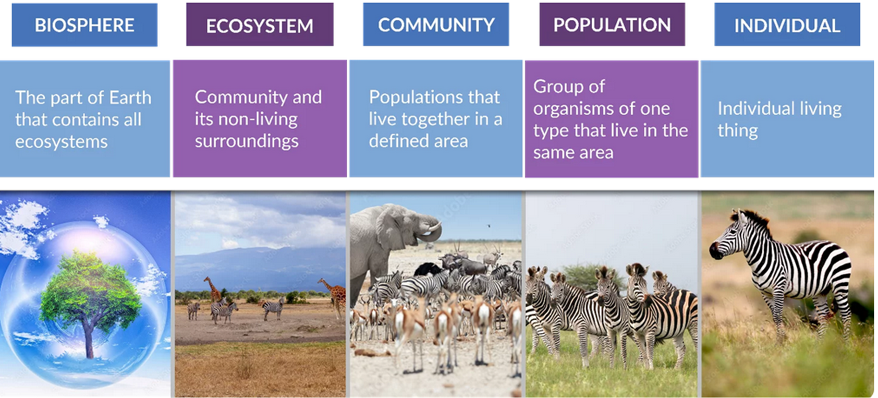
Ecological Levels
Individual
Population
Community
Ecosystem
Biosphere
1
2
3
4
5

Slide 8
Classification of Ecology

Slide 9
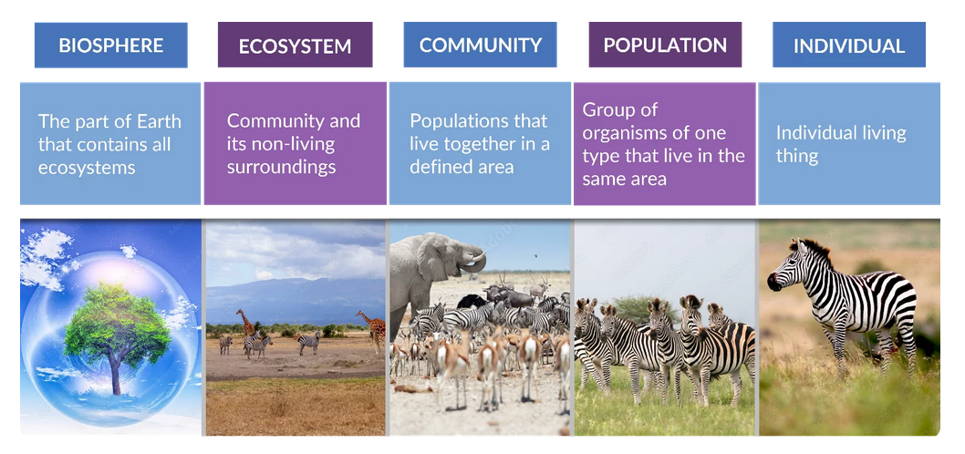
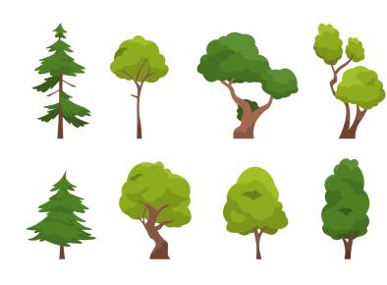
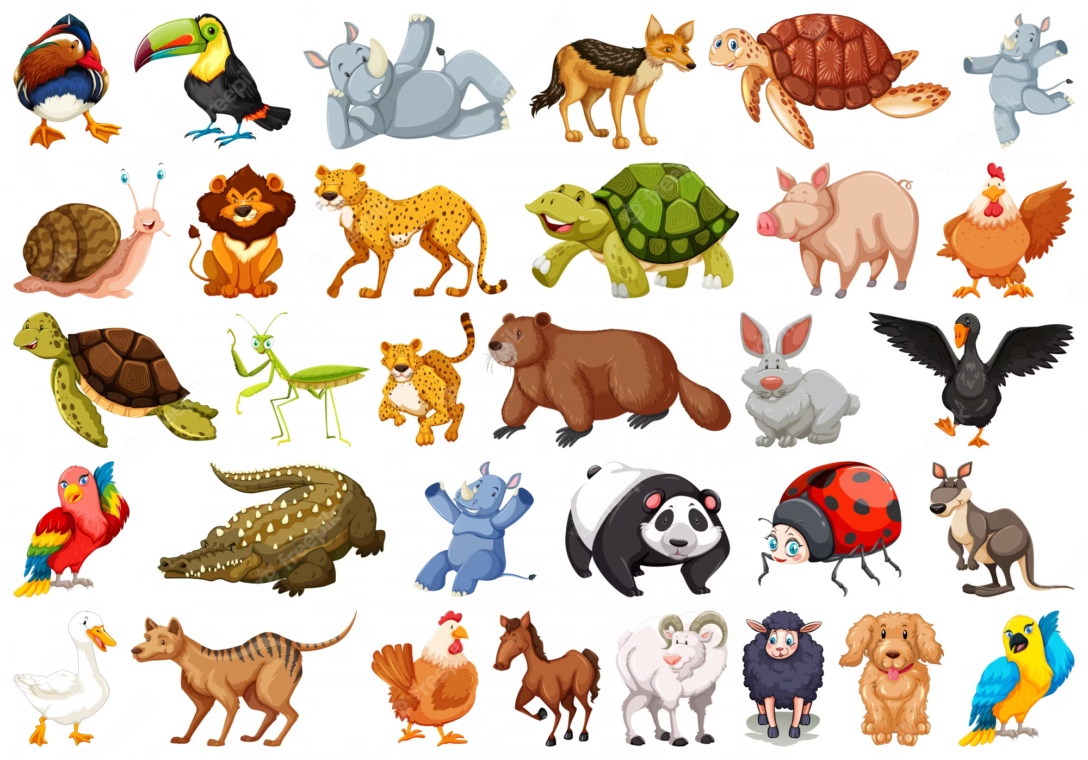
Classification of Ecology
Based on the study area, ecology is classified into two types,
  Autecology
    study of an individual species and/or population.
  Synecology
    study of communities, their composition, and their behavior.
Based on taxonomic affinities;
  Plant ecology
  Animal ecology
Study of Individual Species
Study of community
Animal ecology
Plant ecology

Slide 10
Classification based on habitat
Terrestrial ecosystem
Aquatic ecosystem
Forest ecosystem
Grassland ecosystem
Desert ecosystem
Fresh water ecosystem
Marine ecosystem
Lentic
Stationary freshwater body
Lotic
Free-flowing freshwater body
Lake ecosystem
Pond ecosystem
River ecosystem
Ocean ecosystem
Estuarine ecosystem
Includes organisms that can use atmospheric O₂ for respiration
Includes organisms that can use dissolved O₂ for respiration
On the bases of Amount of vegetation
On the bases of salinity

Slide 11
Terrestrial Ecosystem

Slide 12
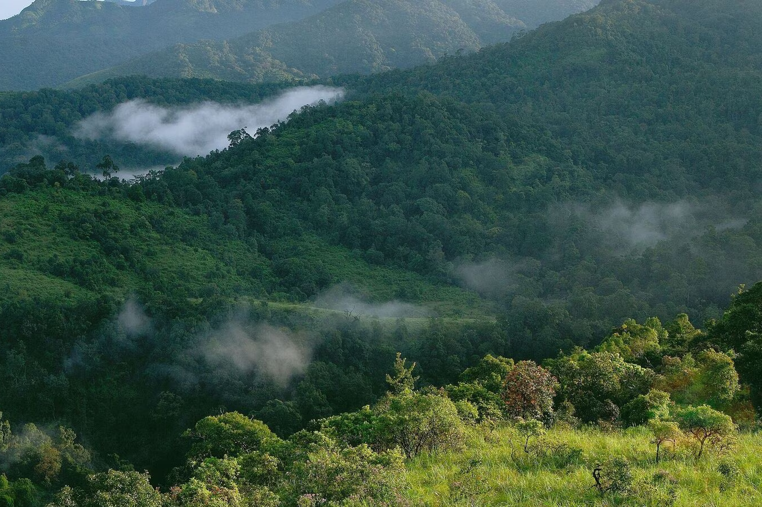
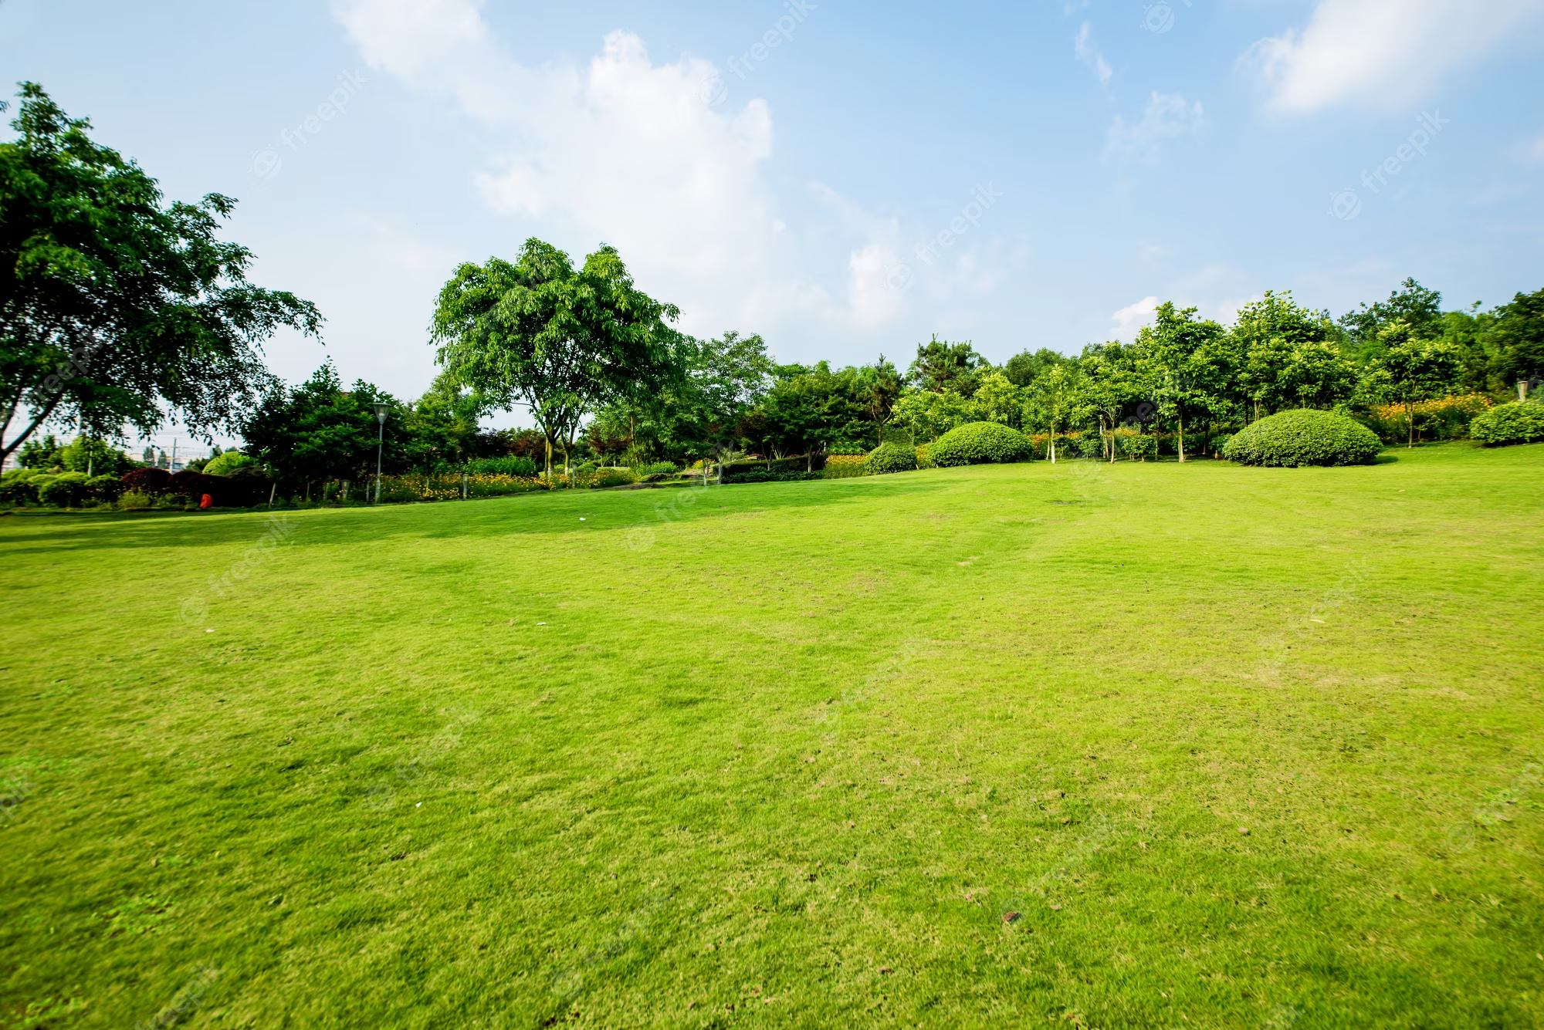
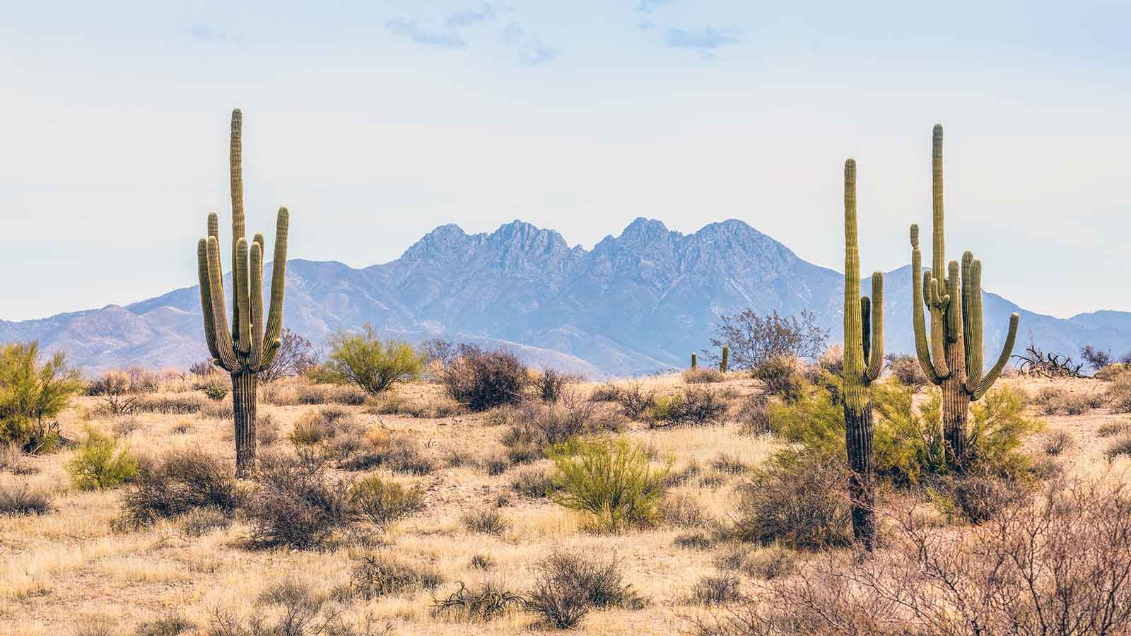
Terrestrial Ecosystem
Terrestrial ecosystem is further divided into various sub-parts on the basis of the amount of vegetation (plant species).
Terrestrial ecosystem
Forest ecosystem
Grassland ecosystem
Desert ecosystem

Slide 13
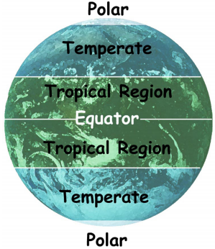
a) Forest Ecosystem
Forest ecosystems have predominance of trees, interspersed with large number of herbs, shrubs, climbers with variety of wild animal and birds.
Depending upon the its region and rainfall it receives, it is classified in several groups.
Tropical rain forest
Tropical deciduous forest
Tropical scrubs forest
Forest ecosystem helps enhancing water resource in quality and quantity.
Forest gives shelter to wild life and also acts as sink for carbon dioxide.
Temperate rain
Temperate deciduous
Evergreen conifers

Slide 14
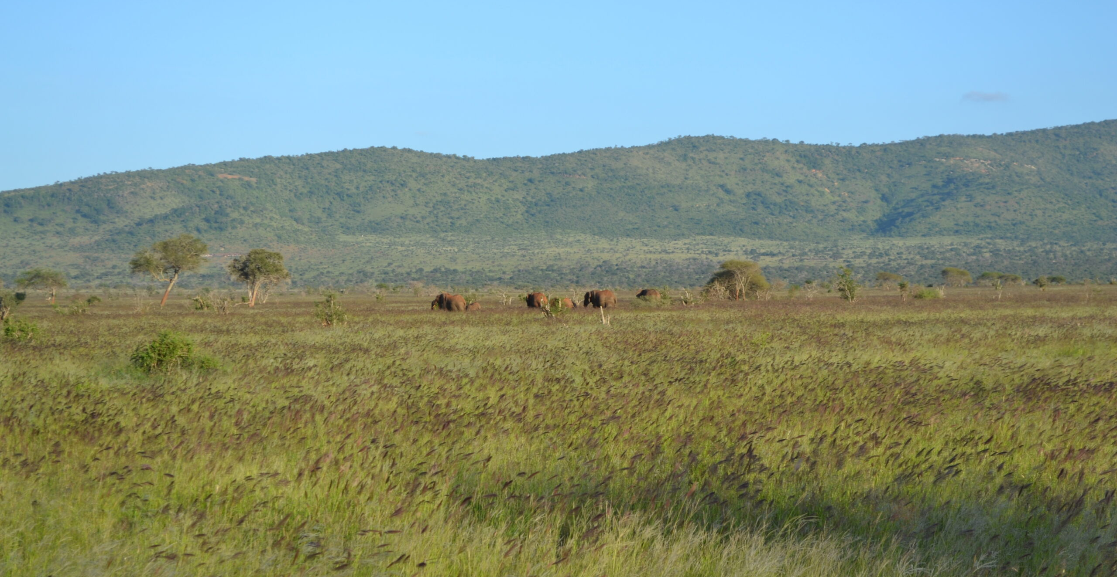
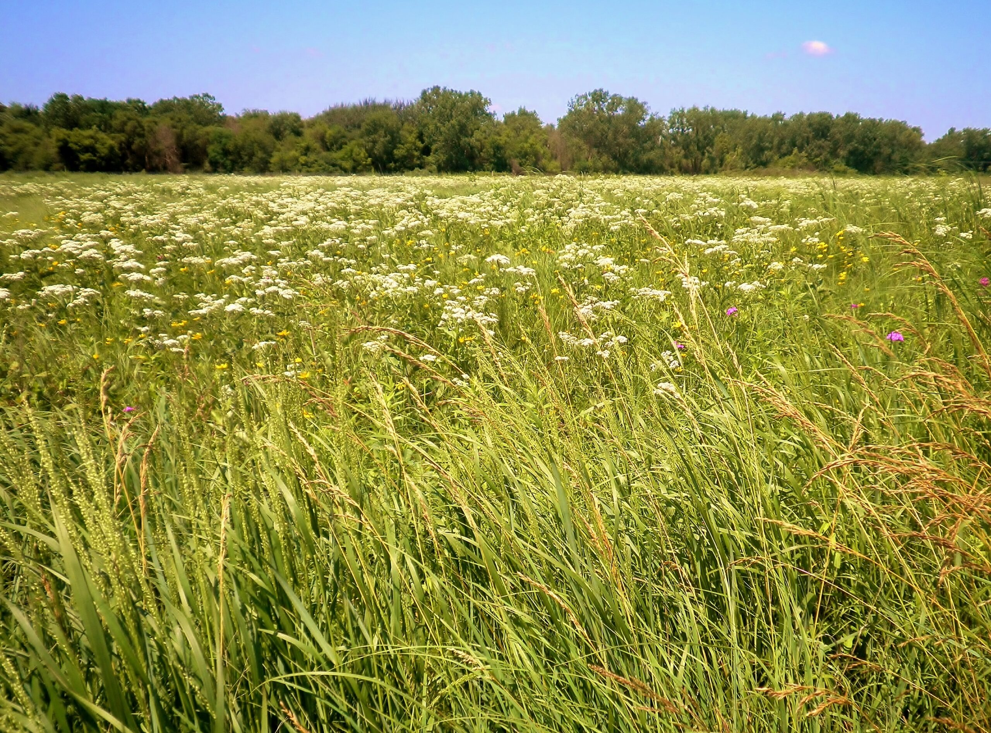
b) Grassland Ecosystem
Grasslands are dominated by grass species but also sometimes allow the growth of a few trees and shrubs.
Rainfall is average but erratic.
About 4.6 x 10⁷ km² of the earth’s surface is covered with grassland.
  Limited grazing helps improve productivity but overgrazing leads to the degradation of land use.
Grasslands are highly fertile and have large amounts of organic compounds.
Grasslands are of the following types:
  Temperate grassland
  Tropical grassland
  Polar grassland
Tropical Grassland
Temperate Grassland

Slide 15
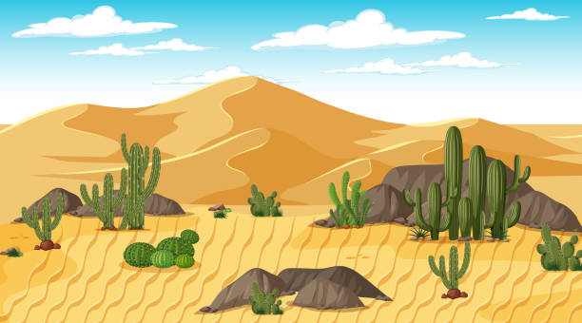
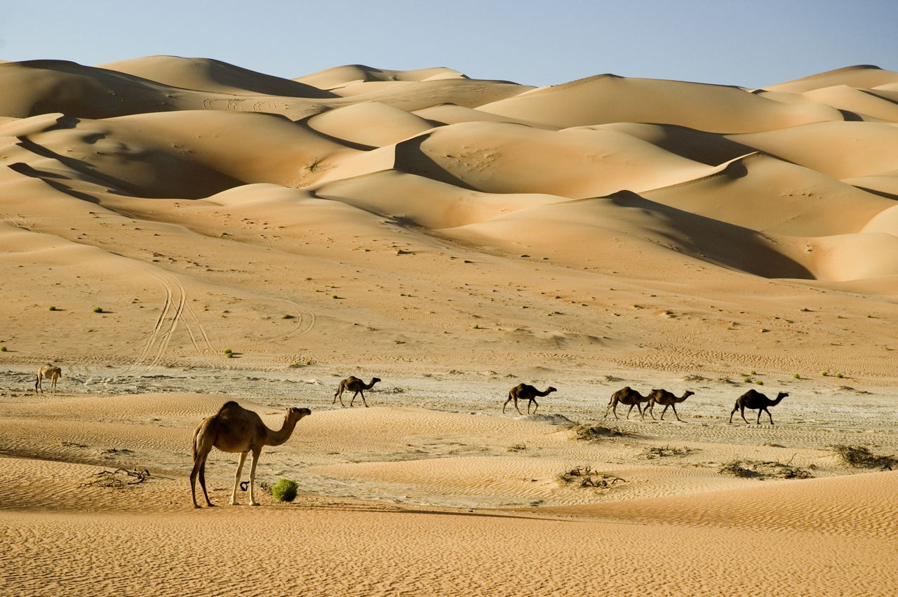
c) Desert Ecosystem
These regions exist where evaporation exceeds precipitation.
  Precipitation is less than 25 cm per year.
Deserts have few species and consist of drought-resistant plants.
The atmosphere is very dry. That’s why, desert soils get cool quickly, making nights colder.
Desert plants and animals have adapted for the conservation of water.
Deserts are of three types:
  Tropical desert (Kutch, Sahara, Namibia, Thar)
  Temperate desert (Mojave, in S. California)
  Cold deserts (Gobi desert, in china)

Slide 16
Aquatic Ecosystem
Freshwater Ecosystem

Slide 17
Aquatic Ecosystem
Freshwater ecosystem is divided into subparts, lentic and lotic, on the basis weather the water body is stationary or moving.
Fresh Water ecosystem
lentic
lotic
Pond ecosystem
River ecosystem
Lake ecosystem

Slide 18
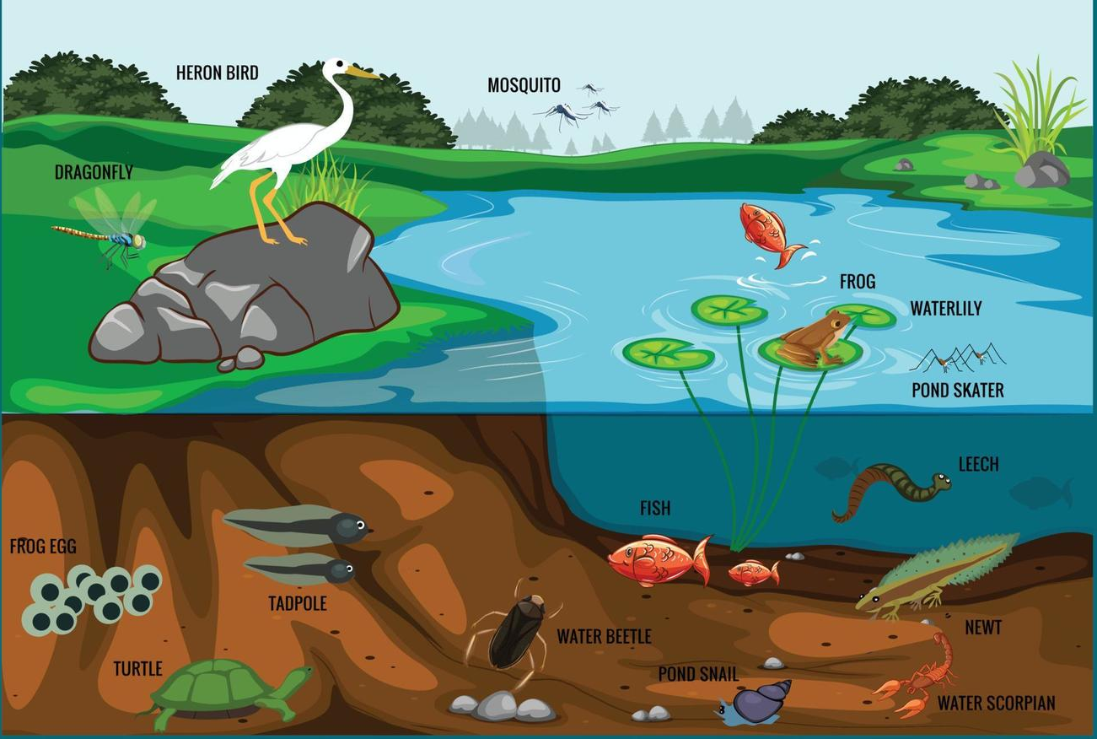
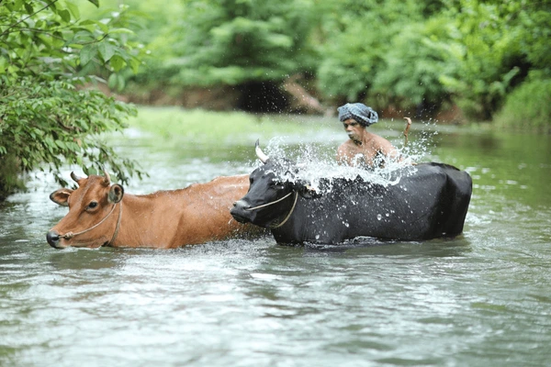
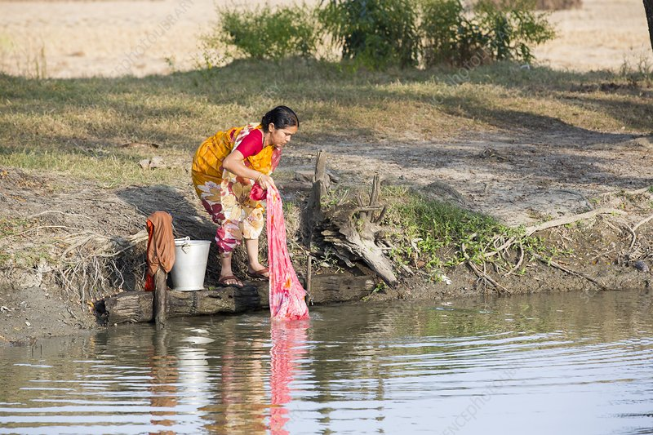
a) Pond Ecosystem
It is a self-sufficient and self-regulating ecosystem.
Location, size, depth, and substratum of a pond influence biology of the pond ecosystem.
Ponds are exposed to tremendous anthropogenic activities (i.e. human activities).
  Washing clothes
  Bathing,
  Swimming,
  Cattle bathing, etc.
Therefore it gets polluted.
https://www.shutterstock.com/search/bathing-cattle-cattle
https://www.sciencephoto.com/media/653965/view/a-woman-washing-clothes

Slide 19
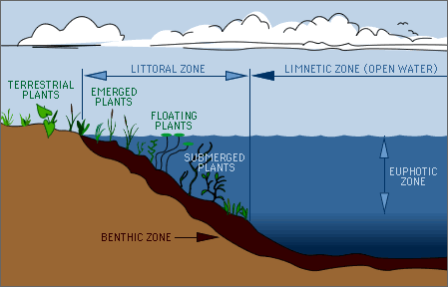
b) Lake Ecosystem
Lakes are usually big freshwater bodies with standing water.
The lake’s biological activities, is largely determined by the availability of light and oxygen.
Important biological zones are namely:
  Littoral zone:
    Zone of shallow water near a shore, in which rooted plants exist.
  Euphotic zone:
    The upper layer through which sunlight can penetrate, in deep water main plant is algae (લીલ).
  Benthic zone:
    Part where the sediments of dead organism in lake gets deposited.

Slide 20
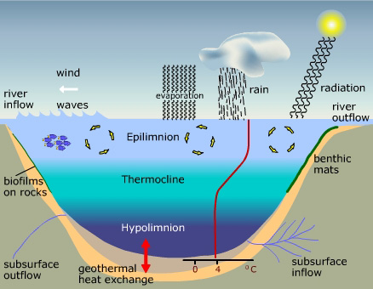
b) Lake Ecosystem
Stratification in Lake
Lakes show stratification based on temperature difference.
During summer-time top water becomes warmer than the bottom layer, making distinct layers;
  Epilimnion: warm, lighter, circulating top surface
  Thermocline: a sharp decrease in temperature
  Hypolimnion: cold, viscous, non-circulating bottom layer

Slide 21
c) River Ecosystem
Rivers is a large stream, that flows downwards from highlands, through plains, and into sea.
  So, the river ecosystem shows a series of different conditions/stages.
In the source stage, high land part (Origin)
  Water is cold & clear.
  Flows with high velocity and high dissolved oxygen.
  Plants, in this phase, are attached to rocks/soil.
  Fishes are cold water & high oxygen requiring (e.g. trout)
In the transfer stage (second stage ), in plains having gentle slopes,
  The water is warmer, and supports the growth of the plant and less O₂ requiring fishes.
  This plain region is covered with soil so it gets eroded.
  So, Moving downstream in the plains, rivers shape the landforms.
In the deposition stage (third stage ),
  water region is very rich in bio-diversity (more types of species can be seen).
  The carry large amount of silt and create deltas before merging into the oceans.

Slide 22
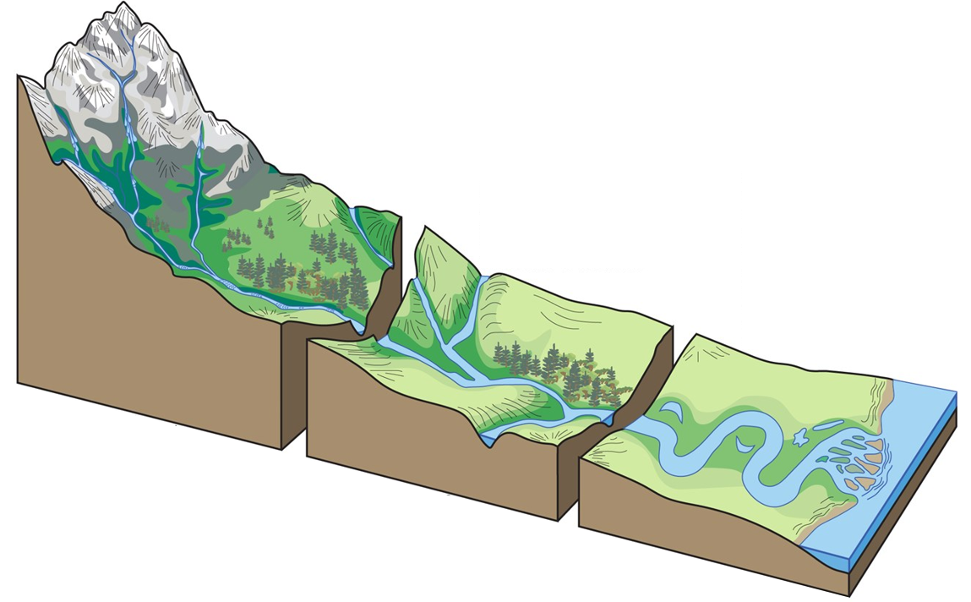
Small streams generated on highland part
River taking its large form, and carries large amount of soil with it.
Soil/silt carried by river get deposited at the meeting point of ocean and river.
Source Stage
Transfer Stage
Deposition Stage

Slide 23
Aquatic Ecosystem
Marine Ecosystem

Slide 24
Aquatic Ecosystem
Marine ecosystem includes, ocean ecosystem and estuarine ecosystem.
Marine ecosystem
Ocean ecosystem
Estuarine ecosystem

Slide 25
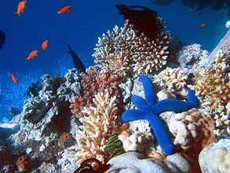
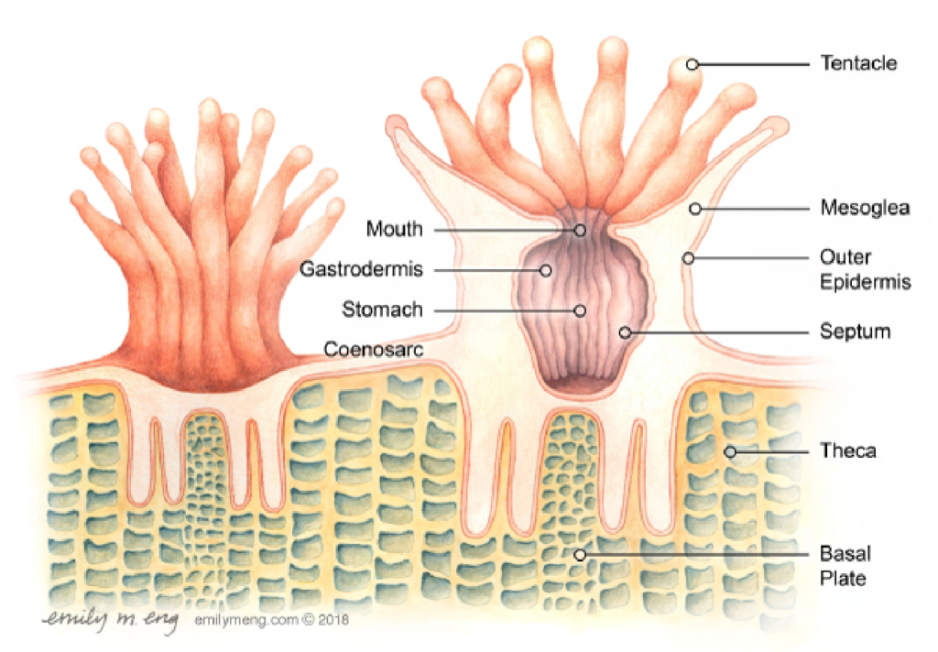
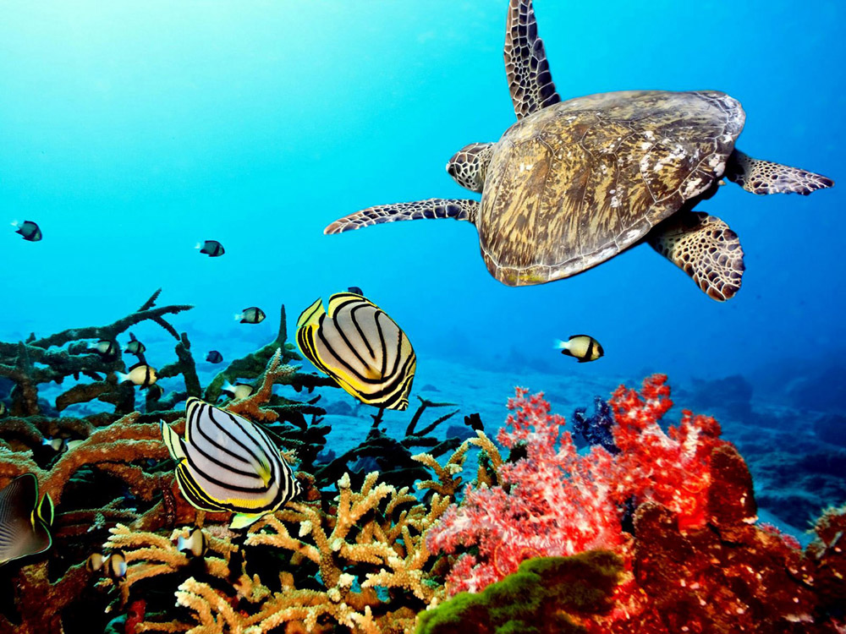
a) Ocean Ecosystem
Ocean ecosystem covers around 70-75% of the earth’s surface, it represents the largest and most diverse ecosystem of all.
It plays an important role in the survival of 2,50,000 marine species.
It also includes coral reef ecosystems.
Oceans have two major life zones.
  Coastal zone: Shallow, relatively warm, ample sunlight
  Open sea: Deeper part, away from the continental shelf.

Slide 26
a) Ocean Ecosystem
Open sea is further divided vertically into three parts.
Euphotic zone:
  It is the zone up to which sunlight is observed.
  As it receives an abundant(large) amount of sunlight, it shows high photosynthetic activity.
Benthic/bathyal zone: Firm ground part at intermediate depth.
  It is host to sand, silt, and decomposed material.
  Starfishes, sponges can be observed here.
  This region is cold (as not much light is observed in the zone).
Abyssal zone: it is the deepest part of the ocean.
  This zone is very cold and pressurized.
  As there is no sunlight, it has no primary source of energy.
  Here, small organism consumes H₂S and other minerals are produced by existence and movement of tectonic plate.

Slide 27
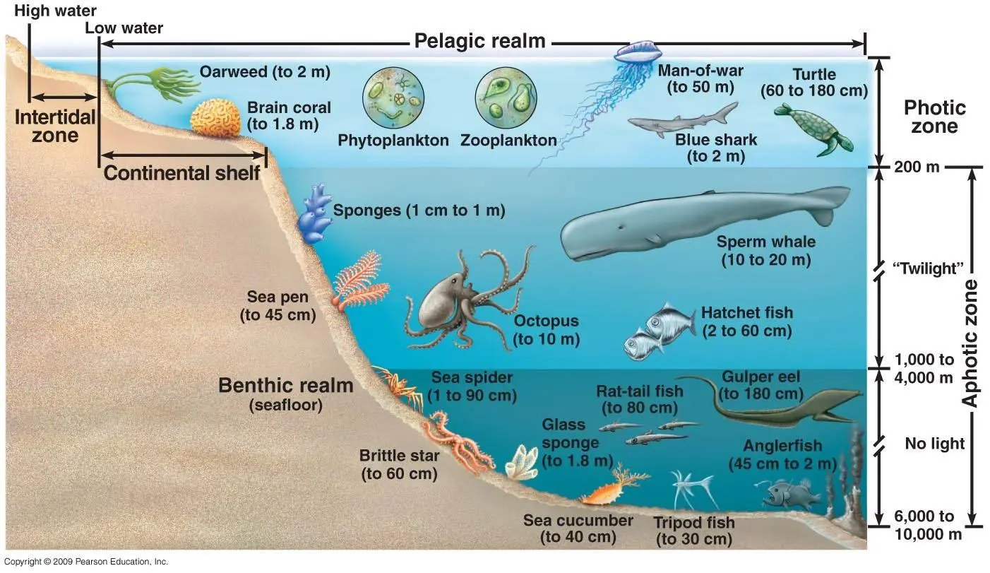
Euphotic Zone
Benthic Zone
Abyssal Zone
Marine Ecosystem

Slide 28
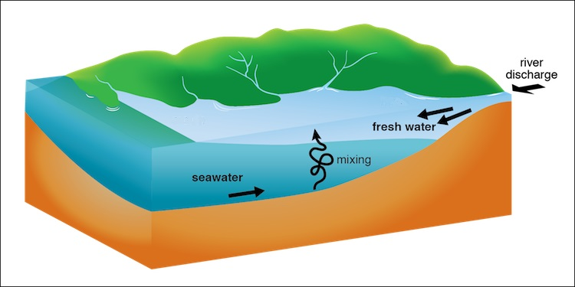
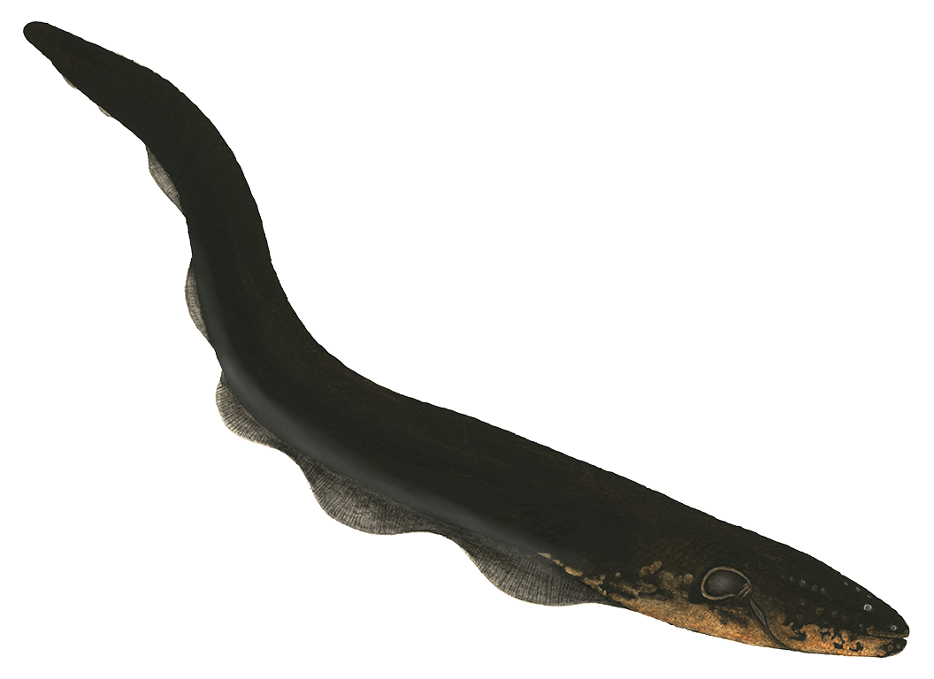
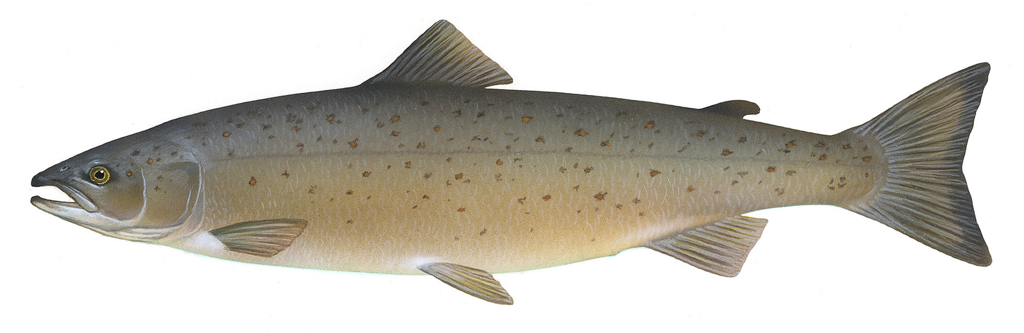
b) Estuarine Ecosystem
An estuary (એસટ્યૂઅરી) is a semi-closed coastal water body, which has free connection with sea.
It contains, salt water mixed with fresh water from the surrounding area.
It’s region (area) is strongly affected by tidal action.
Estuaries have rich biodiversity.
  There are many migratory species of fish like eels and salmon.
  They live half of their life in fresh water and half in marine water.
  Estuaries are ideal places for them to rest while migrating and get abundant amounts of food.
Salmon
Eel

Slide 29

Environmental Studies (ES)
Prof. Arjun Chavada
Civil Engineering Department
arjun.chavada@darshan.ac.in
8200802523

